Slide 1



Renew My Body: Yoga for Health Promotion
RenewU Workshop
© University of Central Florida​

Slide 2


Important
Disclosures
This material is for informational purposes only. It does not replace the advice or counsel of a health care professional. You should consult with and rely on the advice of your physician or health care professional for the management of your health. Never disregard professional medical advice or delay in seeking it because of something you have learned in this course.
Materials found on
Renewunow.org
© University of Central Florida​

Slide 3
Are you signed up to RenewU?
Register here to gain access to other RenewU resources and complete a brief post-session survey!
© University of Central Florida​
Notes:
Presenter notes: Encourage participants to register for RenewU and complete the post-session survey (Only 3 Questions) RenewU has resources for individuals that offer continuing education credits for all ten featured interventions on RenewU.
By a show of hands determine if anyone needs to register and please allow 5-10 minutes at the beginning for participants to complete registration process if anyone is doing so.

Slide 4


Objectives
  Define yoga​
  Discuss why yoga is important to promote health​
  Identify yoga interventions that could improve own health
© University of Central Florida​
Notes:
Presenter Notes: Let's take a moment to listen to our breath and arrive at this moment, letting go of the previous moment. Inhaling and exhaling

Slide 5


What is Yoga?
Yoga is a relaxation technique that has 3 components:​
Bodily Postures
(Asanas)​
Breathing Exercises (Pranayama)​
Meditation/
Mindfulness
© University of Central Florida​
Notes:
Presenter Notes: For the purpose of this class, we will address just three elements of yoga, however Yoga as a cultural practice has many other elements name 8 Limbs of Yoga in their majority spiritual practices related to our living behaviors.​
​
The 8 limbs of Yoga are as follows:​
1. YAMA – Restraints, moral disciplines or moral vows​
2. NIYAMA – Positive duties or observances​
3. ASANA – Posture​
4. PRANAYAMA – Breathing Techniques​
5. PRATYAHARA – Sense withdrawal​
6. DHARANA – Focused Concentration​
7. DHYANA – Meditative Absorption ​
8. SAMADHI – Bliss or Enlightenment​
​
Asanas, Breathing Exercises and Meditation are the ones address on this presentation.​

Slide 6

Why Yoga is Important for Health Promotion?
Strong scientific evidence shows that yoga reduces symptoms of anxiety and improves resilience
Studies show that yoga also reduces stress related to test taking, life events and stressful situations
Yoga does not replace treatment for symptoms of anxiety​
© University of Central Florida​
Notes:
Presenter Notes: Yoga is not a cure to an illness or symptom rather a tool to enhance and support resiliency to these and the stress that might come from it.

Slide 7
How does Yoga
Promote Health?
Yoga practices decrease blood pressure and heart rate in stressful situations ​
Yoga practices decrease stress hormones circulating in the blood
© University of Central Florida​
Notes:
Presenter Notes: The awareness which characterizes Yoga practices allows the body to regulate our reaction to stressful situations.

Slide 8
What are some Yoga Interventions?​
Chair
Yoga
Guided
Meditation
Breathing Exercise
Mindfulness exercises
© University of Central Florida​
Notes:
Presenter Notes: Yoga’s incorporation of meditation and breathing can help improve a person’s mental well-being. During the Physical practice of Yoga (Asanas or Poses) breathing is incorporated to help the body and mind to encourage rhythm and awareness.

Slide 9
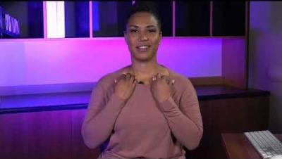
Breathing Exercise
Dirga Pranayama​ (Three-part breath)
https://www.youtube.com/watch?v=FIAyvA1hKbo&t=1s
© University of Central Florida​
Notes:
Presenter notes: Encourage beginners as they advance - When you have a good feel for the breath moving in and out of each position, practice without the hands. Eventually relax the effort of the pranayama and breathe into the three positions gently, feeling a wave of breath move up and down the torso.​
Shoulders away from the ears, softening the gaze or even closing your eyes if that's comfortable.​
​
The 3 part breath or complete breath is nourishing, calming and relaxing.​
Dirga Pranayama is called the three part breath because you are actively breathing into three parts of your abdomen.​
​
Practice and respond to the reflection prompts in the handout.

Slide 10
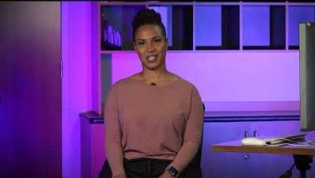
Chair Yoga
Chair yoga is a gentle form of yoga that can be done while sitting.
You can do chair yoga nearly anywhere you can find a place to sit.
https://www.youtube.com/watch?v=YnU_iLnWFbM&t=1s
© University of Central Florida​
Notes:
Feeling sit bones on the chair and feet always supported by the ground. Beginning with hands relaxed and placed on your thighs ​
​
Practice and respond to the reflection prompts in the handout.

Slide 11
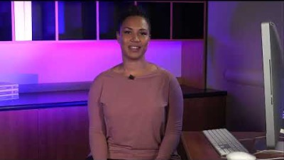
Guided Meditation
Guided Meditation is a way of connecting your body and mind to the present moment, the here and now, the earth.​
https://www.youtube.com/watch?v=091CbqSZJ5Q&t=1s
© University of Central Florida​
Notes:
This is a great way to bring us back into focus, to either shift gear or start our day. When listening to a guided meditation, be guided by the sound of the voice guiding and if any distractions arrive, acknowledge them and come back to listening to your breath.​
​
Practice and respond to the reflection prompts in the handout.

Slide 12
Mindfulness Exercises
There are Yoga
mindfulness practices,
but for this toolkit refer to the CBT/Mindfulness module to learn more about mindfulness
practices.
© University of Central Florida​
Notes:
Presenter notes: To learn more about mindfulness practices refer to our CBT/Mindfulness module​

Slide 13
Yoga Practice Debrief
  Which yoga practice seemed the most effective in reducing stress?​
  Which yoga practice is the most accessible to you during the workday?​
  Where do you see an opportunity to continue your yoga practice in your daily routine?
© University of Central Florida​
Notes:
Presenter notes: Debrief together on how the yoga practice was for you. Discuss strategies for implementing it into your daily routine. If you are already practicing yoga share your tips from personal experience. ​

Slide 14

Conclusion
Take Home Points
Practicing yoga exercises can improve your health and prevent the harmful effects of daily stress​
If you decide to do yoga exercises, please disclose to your healthcare provider so that they can advise on integration with your current treatment​
Do not use yoga to replace treatment prescribed by your health care team​
© University of Central Florida​
Notes:
Presenter Notes: Yoga should be use as a tool​

Slide 15
Please Complete the Post-session Survey
Register to gain access to other RenewU resources & complete a brief post-session survey!
Post-session survey link:
© University of Central Florida​
Notes:
Presenter notes: Encourage participants to register for RenewU and complete the post-session survey (Only 3 Questions) RenewU has resources for individuals that offer continuing education credits for all ten featured interventions on RenewU.
*If this is the first RenewU post-session or module survey they are completing they are eligible to receive a $25 gift card.

Slide 16
Disclosure
This project was supported by the Health Resources and Services Administration (HRSA) of the U.S. Department of Health and Human Services (HHS) under grant number 6 U3NHP45418 of the Health and Public Safety Workforce Resiliency Training Program for $1,496,128. This information or content and conclusions are those of the author and should not be construed as the official position or policy of, nor should any endorsements be inferred by HRSA, HHS or the U.S. Government.
© University of Central Florida​
Notes:
Presenter notes: please show the disclosure after presentation

