Slide 1


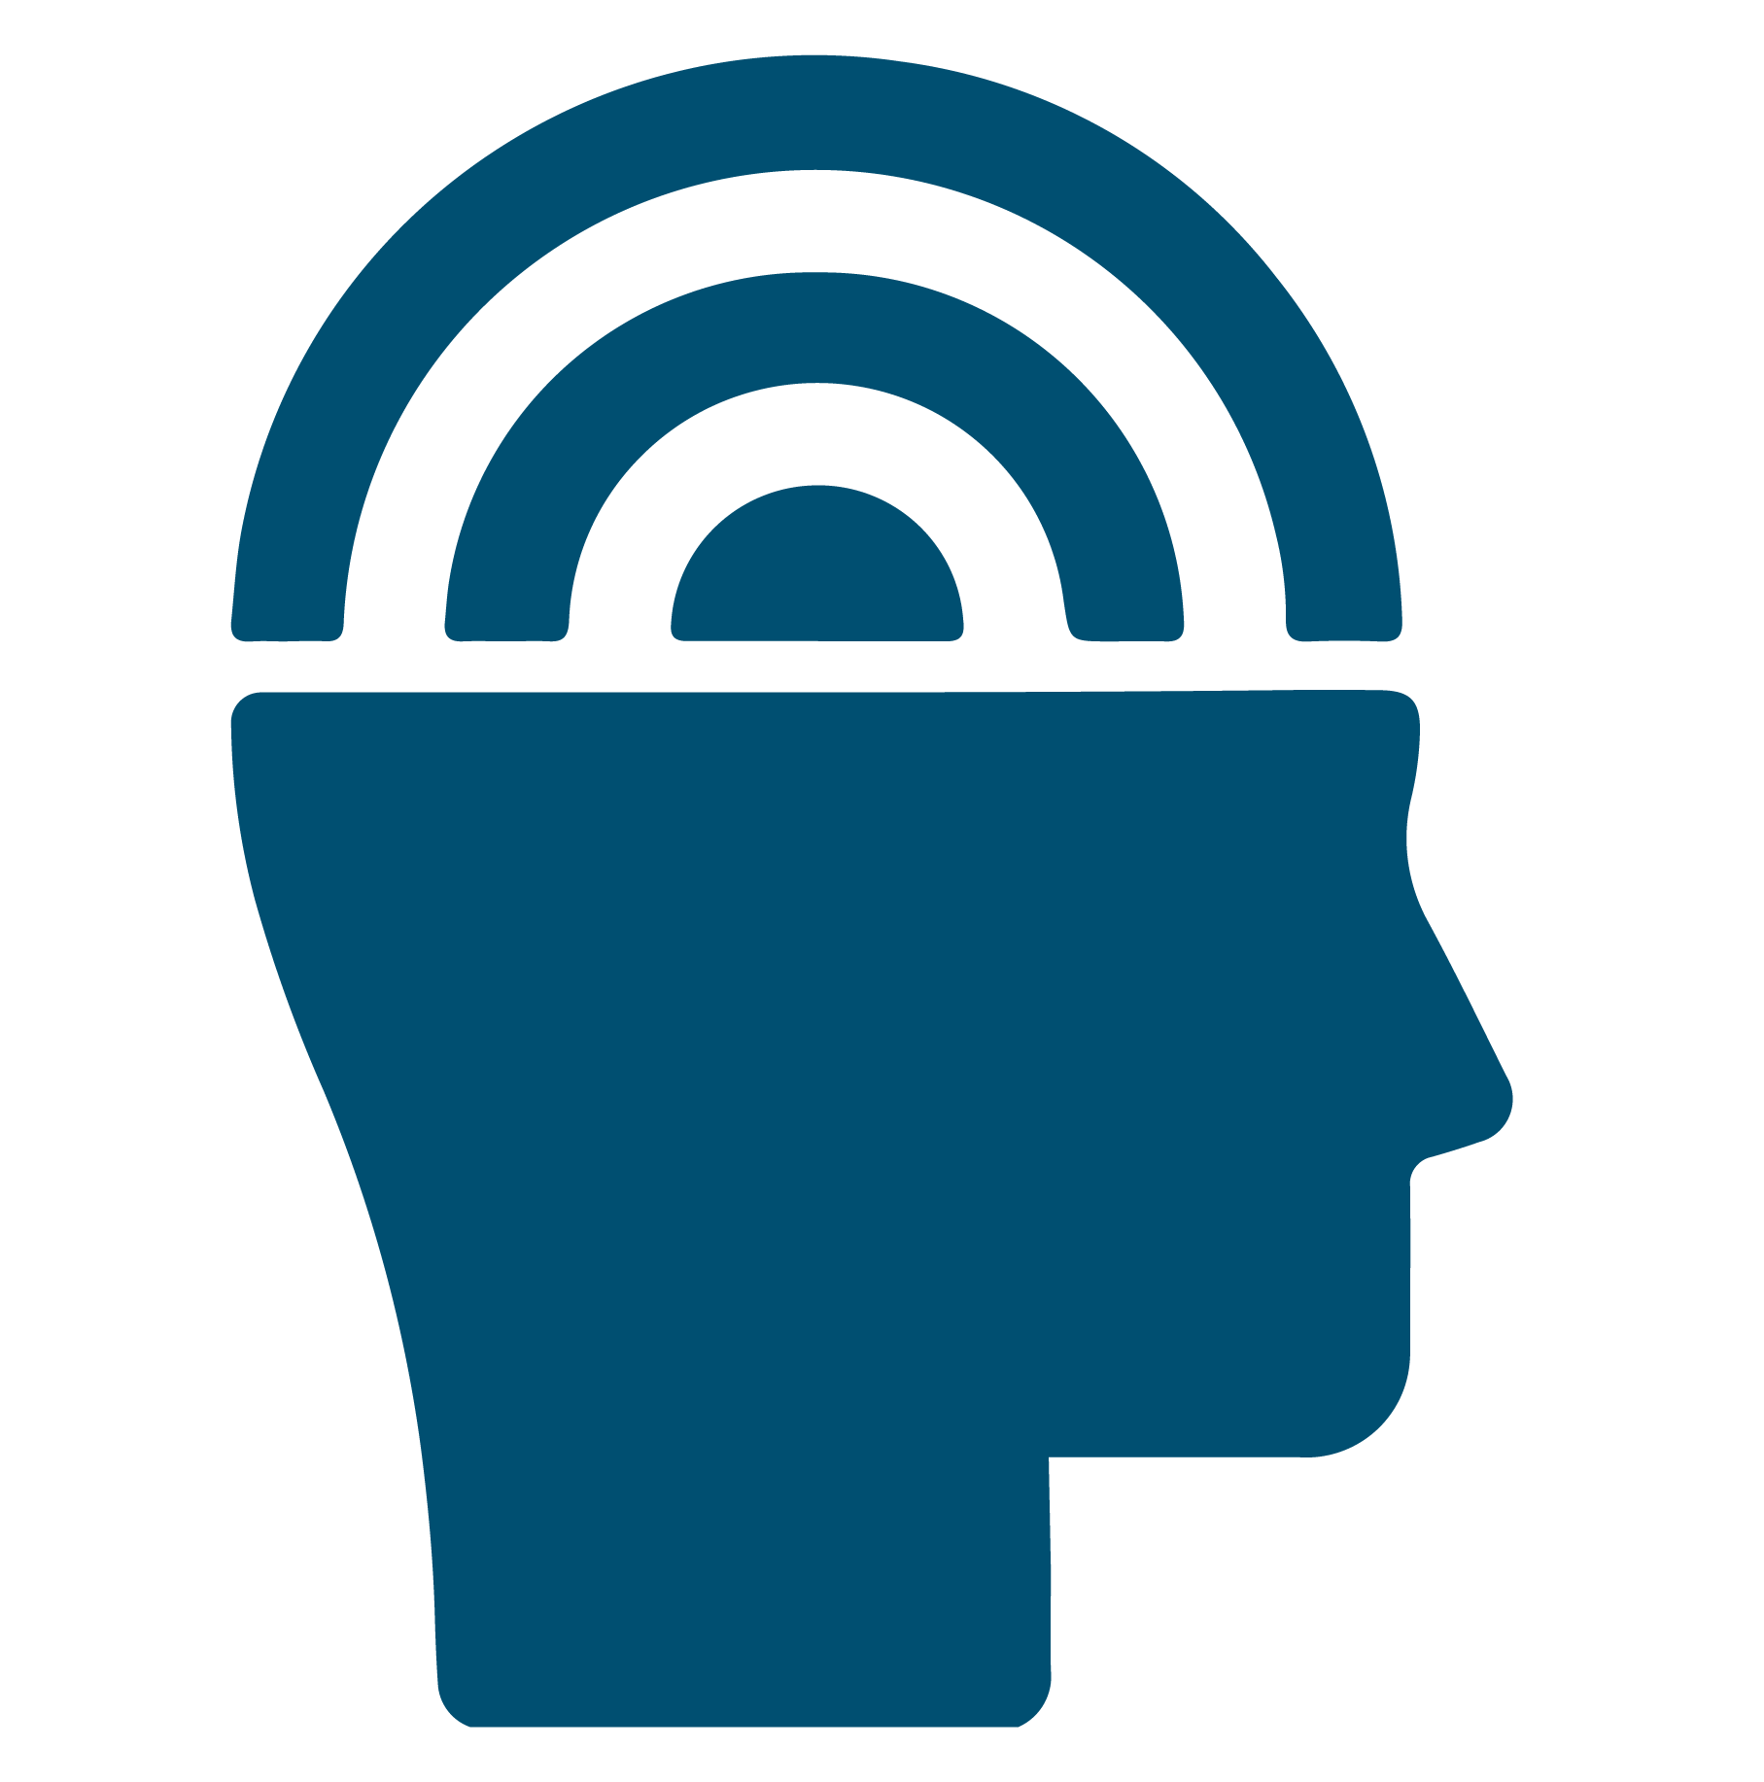
Renew My Mind: Psychological Detachment
RenewU Workshop
© University of Central Florida​

Slide 2

Important
Disclosures
Materials found on Renewunow.org
This material is for informational purposes only. It does not replace the advice or counsel of a health care professional. You should consult with and rely on the advice of your physician or health care professional for the management of your health. Never disregard professional medical advice or delay in seeking it because of something you have learned in this course.
© University of Central Florida​

Slide 3
Are you signed up to RenewU?
Register here to gain access to other RenewU resources and complete a brief post-session survey!
© University of Central Florida​
Notes:
Presenter notes: Encourage participants to register for RenewU and complete the post-session survey (Only 3 Questions) RenewU has resources for individuals that offer continuing education credits for all ten featured interventions on RenewU.
By a show of hands determine if anyone needs to register and please allow 5-10 minutes at the beginning for participants to complete registration process if anyone is doing so.

Slide 4


Objectives
  Define psychological detachment​
  Discuss why psychological detachment is important to health promotion​
  Identify psychological detachment​ practices for self-care​
  Implement psychological detachment​ practice activity for your health promotion​
  Reflect on experience with psychological detachment
© University of Central Florida​
Notes:
Today we will be discussing psychological detachment techniques that you can use for your self-care and practice when you needed. ​

Slide 5

What is Psychological Detachment?
Psychological detachment refers to an
individual’s
sense of being
away from work.
Psychological detachment implies
mentally leaving work behind and
gaining distance from one’s job demands.
Psychological detachment is the presence of mind/attention to non-work-related activities.
© University of Central Florida​
Notes:
Psychological detachment refers to an individual's experience of gaining mental distance to work, to make a pause in thinking about work-related issues, thus to ''switch off". Psychological detachment is an ability of recovery from work-related stress that allows individuals to reduce burnout symptoms.

Slide 6

Why is Psychological Detachment Important for Health Promotion?
Psychological detachment activities significantly:
Reduce job-related stressors
Reduce psychosomatic complaints
Increase in work engagement
© University of Central Florida​
Notes:
Research has shown that psychological detachment from work is beneficial for various aspects of employee well-being and job performance. ​
​
*Psychosomatic complaints – psychological condition involving physical conditions – headache, stomach pain can be reduced. ​

Slide 7
Karabinski, et al., 2021.
Article Summary:
Interventions targeting primary appraisal processes (more on this below) are effective in decreasing job stressors and promoting mindfulness, sleep, activities outside of work, and emotional regulation.

Slide 8
Findings (Karabinski, et al., 2021.)
In a Meta-analysis of 10 Studies on detachment. Interventions targeting primary appraisal processes are effective in reducing job-stressors.
Suggested interventions reveal a positive effect on detachment from work (Cohen's d. =0.36, p<.001).
Among the interventions studied these were the most effective:
  Boundary management (d=0.65, p < .001)
  Emotion regulation (d=0.48, p < .001)
  Sleep improvement strategies (d=0.88, p < .001)
These interventions also yielded significant results:
  Mindfulness (d=0.46, p < .001)
  Problem-focused coping (d=0.38, p = .001)
  Engagement in recovery activities (d=0.39, p < .001)
Notes:
Presenter notes: article findings

Slide 9
Sonnentag, et al., 2010.
Article Summary:
Psychological detachment decreases stress and psychosomatic complaints.

Slide 10
Findings (Sonnentag, et al., 2010.)
A longitudinal study (12-month) with 309 human service employees showed that psychological detachment from work during off-job time is an important factor that helps to protect employee well-being and work engagement. Longitudinal evidence shows that psychological detachment works as a moderator and suggests that job demands such as time pressure are less harmful when employees mentally disengage from their job during off-job time.
When psychological detachment is low, job demands were related to an:
Increase in psychosomatic complaints (β= 0.164, p < .01)
Decrease in work engagement over time (β = - 0.305, p < .01)
Notes:
Presenter notes: article findings

Slide 11
Mechanisms for the Health Effects of Psychological Detachment
Attention Restoration
& Creativity
Default
Mode Network
Recovery
Johnson, 2015.
Côté & Miners, 2006.
Notes:
Presenter notes:
Mechanism of Recovery - Psychological detachment from work during non-work time provides a temporary break from job demands which allows recovery to occur and prevents emotional exhaustion.
2. Mechanism of the Default Mode Network - When external attentional demands are reduced (e.g., work-related tasks), the Default Mode Network (DMN) is recruited. DMN includes a set of brain regions (prefrontal cortex, posterior cingulate cortex/precuneus region, and the temporoparietal junction). The DMN seems to play an important role when you’re focusing attention inward, rather than focusing on the external world.
3. Mechanism of Attention Restoration and Creativity - Attending to stimulus classified as “soft” fascination is beneficial for restoration because while still capturing attention, you do not entirely occupy the mental space in your head. Settings and activities that draw on soft fascination aid attention restoration and creativity by leaving enough free space to reflect on your thoughts. You may find such opportunities for reflection during a walk in the woods or a brief respite looking out the window.

Slide 12
What are Psychological Detachment Practices?
Boundary management
Mindfulness
Engagement in recovery
activities
Emotional regulation
© University of Central Florida​
Notes:
Four areas​
Engagement in recovery activities (e.g., hobby, family activities).​
​
Mindfulness (e.g., breathing or sitting meditations). ​
​
Boundary management (e.g., cutting off work after 5pm). ​
​
Emotional regulation (e.g., acceptance of negative emotions, and self-support in difficult situations)​

Slide 13
Strategies for Implementing
Psychological Detachment
  Identify your favorite or most beneficial recreational activities​
  Divert attention away from the work situation and associated job demands through practicing mindfulness and boundary management
  Take precautions against hindrances to engaging in these activities
  Practice meditative state of thinking "nothing"​
  Being distracted from the job by experiencing activities in other domains (e.g., taking a language class or volunteer work). ​
  Create strict boundaries around working hours (e.g., having unplugged dinners and avoiding spending relaxation time at your computer).
© University of Central Florida​
Notes:
Ask audience what other strategies could foster pscyh. detachment from work during non-work hours. ​

Slide 14

Strategies for
Boundary Management
https://www.youtube.com/watch?v=U5mjprrK-XQ
© University of Central Florida​
Notes:
Presenter notes: Walk among small groups to facilitate and encourage discussion.​

Slide 15
Psychological Detachment: Boundary Management Areas
Temporal​
Physical​
Behavioral​
Communicative
© University of Central Florida​
Notes:
Presenter notes: Individuals utilize behaviors, events or episodes to manage boundaries and negotiate the demands of work and their personal life. Kreiner et al. (2009) classified four types of boundary management tactics: ​
​
Temporal – Controlling time or using scheduling in order to reduce boundary violations​
Physical – Using physical space as boundaries of the work and personal domains​
Behavioral – Actively managing technology or tools to facilitating boundary management ​
Communicative – Articulating acceptable boundary behavior of others

Slide 16
Boundary Management
Self-Assessment
Complete the Self-Assessment and the reflection questions​
Discuss your responses with your group to brainstorm additional boundary strategies specific for your team.
© University of Central Florida​
Notes:
Presenter notes: Individuals utilize behaviors, events or episodes to manage boundaries and negotiate the demands of work and their personal life. Kreiner et al. (2009) classified four types of boundary management tactics: ​
​
Temporal – Controlling time or using scheduling in order to reduce boundary violations​
Physical – Using physical space as boundaries of the work and personal domains​
Behavioral – Actively managing technology or tools to facilitating boundary management ​
Communicative – Articulating acceptable boundary behavior of others

Slide 17

Small Group Discussion
How does our work culture play into your personal boundary management?​
How could our work culture be more supportive of setting and managing boundaries?
© University of Central Florida​
Notes:
Presenter notes: Did the discussion help your team identify specific strategies or areas where your team could grow in boundary management tactics?

Slide 18
Conclusion
Take Home Points
Psychological detachment activities are effective in relieving work stress​
Psychological detachment is most successfully practiced when work-boundaries are clearly stated and maintained on a daily basis. ​
The more an individual can find ways to totally detach from the source of stress, the more effective they will be in managing stress.​
© University of Central Florida​
Notes:
​
Boundary setting is a primary strategy for establishing boundaries between one’s work and home life. Healthy boundaries are critical to living your vision and creating a fulfilling life.

Slide 19
References
Basu, A., Duvall, J., & Kaplan, R. (2019). Attention Restoration Theory: Exploring the Role of Soft Fascination and Mental Bandwidth. Environment and Behavior, 51(9–10), 1055–1081. https://doi.org/10.1177/0013916518774400
Etzion, D., Eden, D., & Lapidot, Y. (1998). Relief from job stressors and burnout: Reserve service as a respite. Journal of Applied Psychology, 83(4), 577-585. https://psycnet.apa.org/doi/10.1037/0021-9010.83.4.577
Heber, E., Lehr, D., Ebert, D. D., Berking, M., & Riper, H. (2016). Web-Based and Mobile Stress Management Intervention for Employees: A Randomized Controlled Trial. Journal of Medical Internet Research, 18(1):e21 https://doi.org/10.2196/jmir.5112
Hülsheger, U.R., Feinholdt, A., & Nübold, A. (2015). A low-dose mindfulness intervention and recovery from work: Effects on psychological detachment, sleep quality, and sleep duration. Journal of Occupational and Organizational Psychology, 88(3), 464-489. https://doi.org/10.1111/joop.12115
Karabinski, T., Haun, V. C., Nübold, A., Wendsche, J., & Wegge, J. (2021). Interventions for improving psychological detachment from work: A meta-analysis. Journal of Occupational Health Psychology, 26(3), 224–242. https://doi.org/10.1037/ocp0000280
Kreiner, Hollensbe, E. C., & Sheep, M. L. (2009). Balancing Borders and Bridges: Negotiating the Work-Home Interface via Boundary Work Tactics. Academy of Management Journal, 52(4), 704–730. https://doi.org/10.5465/AMJ.2009.43669916

Slide 20
References
Li, W., Mai, X., & Liu, C. (2014). The default mode network and social understanding of others: what do brain connectivity studies tell us. Frontiers in human neuroscience, 8, 74. https://doi.org/10.3389/fnhum.2014.00074
Meijman, T. F., & Mulder, G. (1998). Psychological aspects of workload. In P. J. D. Drenth, H. Thierry, & C. J. de Wolff (Eds.), Handbook of work and organizational: Work psychology (pp. 5–33). Psychology Press/Erlbaum (UK) Taylor & Francis.
Sonnentag, S., & Fritz, C. (2007). The Recovery Experience Questionnaire: Development and validation of a measure for assessing recuperation and unwinding from work. Journal of Occupational Health Psychology, 12(3), 204-221. https://doi.org/10.1037/1076-8998.12.3.204
Sonnentag, S., Binnewies, C., & Mojza, E. J. (2010). Staying well and engaged when demands are high: the role of psychological detachment. The Journal of applied psychology, 95(5), 965–976. https://doi.org/10.1037/a0020032
Sonnentag, S., & Fritz, C. (2015). Recovery from job stress: The stressor-detachment model as an integrative framework. Journal of Organizational Behavior, 36(S1), S72– S103. https://doi.org/10.1002/job.1924

Slide 21
Please Complete the Post-session Survey
Register to gain access to other RenewU resources & complete a brief post-session survey!
Post-session survey link:
© University of Central Florida​
Notes:
Presenter notes: Encourage participants to register for RenewU and complete the post-session survey (Only 3 Questions) RenewU has resources for individuals that offer continuing education credits for all ten featured interventions on RenewU.
*If this is the first RenewU post-session or module survey they are completing they are eligible to receive a $25 gift card.

Slide 22
Disclosure
This project was supported by the Health Resources and Services Administration (HRSA) of the U.S. Department of Health and Human Services (HHS) under grant number 6 U3NHP45418 of the Health and Public Safety Workforce Resiliency Training Program for $1,496,128. This information or content and conclusions are those of the author and should not be construed as the official position or policy of, nor should any endorsements be inferred by HRSA, HHS or the U.S. Government.
© University of Central Florida​
Notes:
Presenter notes: please show the disclosure after presentation

