Slide 1


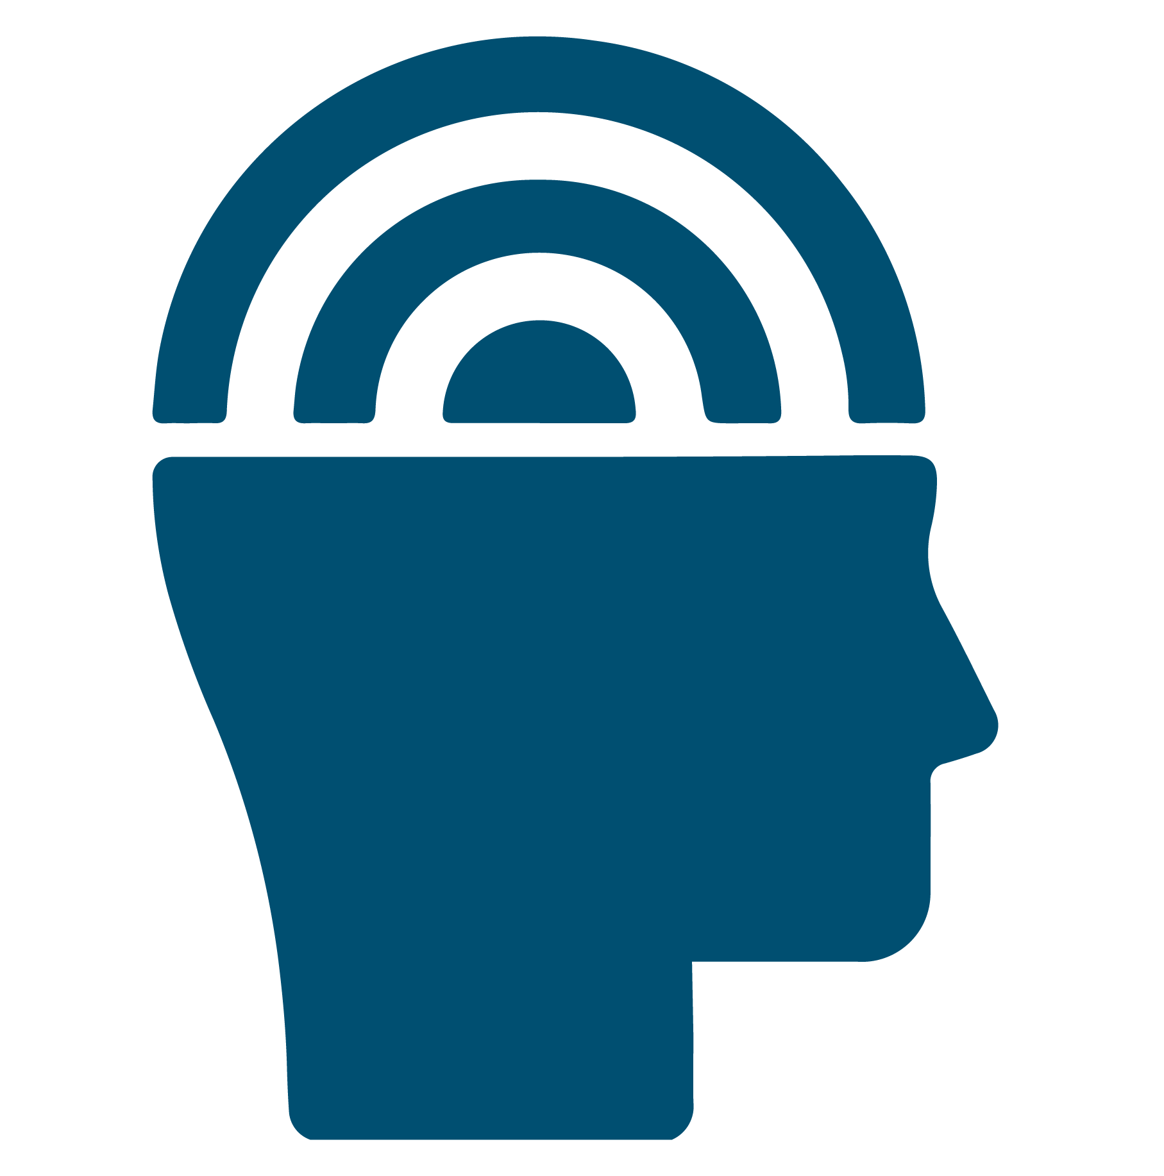
Renew My Mind: Building Emotional Intelligence (EI) to Promote Health​
RenewU Workshop
© University of Central Florida​
Notes:
Presenter note: Welcome to this session on "Building Emotional Intelligence to Promote Health". I (we) are glad you could attend and hope that you will learn something from this session and have a little opportunity to consider the role of emotional intelligence in your own life and relationships.

Slide 2


Important
Disclosures
This material is for informational purposes only. It does not replace the advice or counsel of a health care professional. You should consult with and rely on the advice of your physician or health care professional for the management of your health. Never disregard professional medical advice or delay in seeking it because of something you have learned in this course.
Materials found on
Renewunow.org
© University of Central Florida​

Slide 3
Are you signed up to RenewU?
Register here to gain access to other RenewU resources and complete a brief post-session survey!
© University of Central Florida
Notes:
Presenter notes: Encourage participants to register for RenewU and complete the post-session survey (Only 3 Questions) RenewU has resources for individuals that offer continuing education credits for all ten featured interventions on RenewU.
By a show of hands determine if anyone needs to register and please allow 5-10 minutes at the beginning for participants to complete registration process if anyone is doing so.

Slide 4


This Module will Answer the Following Questions?
  What is Emotional Intelligence (EI)?​
  What are the benefits of EI?​
  How can I measure my EI? ​
  How can I develop EI?
© University of Central Florida​
Notes:
In review of our time today, we will be learning about emotional intelligence, what it is and why it might be a useful skill for your to develop. You will have an opportunity to complete a survey that will give you an idea of your own emotional intelligence level and identify areas where you have strong skills, as well as emotional intelligence areas that you can refine or develop.

Slide 5


What is Emotional Intelligence (EI)?
Unlike how smart you are, EI is a type of intelligence that considers how well you can:​
Identify and control your emotions and thoughts​
Recognize and understand other's emotions​
Control your focus and actions so that you can solve problems or achieve your goals
© University of Central Florida​
Notes:
We are all certainly familiar with 'intelligence' - generally referring to how 'smart' one is. And there are measures of that kind of intelligence, which is more related to how much and how quickly someone can learn, remember or recall information, their problem solving abilities, and how much information they can process at one time. That type of intelligence is more related to memory and cognitive (brain) functioning - or "thoughts"​
​
Emotional intelligence relates to 'feelings' and the "thought-feeling" relationship. There are various definitions and theories about emotional intelligence but the one we will focus on today defines emotional intelligence as - how well you can identify and control your emotions and thoughts, how well you can fecognize and understand other's emotions and how well you can control your focus and actions so that can solve problems or achieve your goals.​
​
And most people who study emotional intelligence consider it more like a skill you can develop than a trait you are born with. And our discussions today are based on that assumption as well...so whatever your current level of emotional intelligence, you aren't stuck there, you can develop emotional intelligence, you can become emotionally 'smart'.

Slide 6

What are the Benefits of EI?
Lower
Levels:
Higher
Levels:
Stress​
Worry or anxiety​
Depression​
Burnout
Physical, mental, emotional, exhaustion
Work performance & satisfaction​
Work interest, attention & productivity
Health​
Well-being
© University of Central Florida​
Notes:
Why does emotional intelligence matter? It matters because, according to studies, people with higher levels of emotional intelligence are less emotionally reactive and report less stress, declines in mood, negative emotions like anxiety and depression, burnout and exhaustion than people with lower levels of emotional intelligence. People with higher levels of emotional intelligence are also more engaged and productive at work, perform better educationally, report more job satisfaction and better health and well-being than people with lower levels of emotional intelligence. ​
​
Considering all the benefits, there is really not anyone who couldn't benefit from building or improving their emotional intelligence skills. ​
​
So Where do you begin?

Slide 7
Perception of Emotions
How can I Develop Emotional Intelligence (EI)?
Managing Own Emotions
Managing Other’s Emotions
Utilization of Emotions
© University of Central Florida​
Notes:
Presenter notes: ​
You can learn about different types of emotional intelligence that the Assessing Emotions Scale measures​
​
Where to begin hint: If you took the Assessing Emotions Scale, each type of emotional intelligence match the different scores you received. Where did you score the lowest? That might be a good place to start learning about emotional intelligence skills you can develop in that area!​
​
Here is the type of emotional intelligence each factor is associated with.​
​
Factor 1: Perception of Emotions – Individuals who score high on this factor are ‘empathic’. They are aware of their own emotions and can recognize the emotions of others based on non-verbal cues. They are aware of changes in their own, and others’, emotions and able to understand why someone feels the way they do. ​
​
Factor 2: Managing Own Emotions – Individuals who score high on this factor are competent at controlling their emotions. They capitalize on positive emotions, seek situations that make them happy. When faced with obstacles, they expect to do well and to have good things happen to them and they use previous successes to stay motivated to overcome obstacles. ​
​
Factor 3: Managing Other’s Emotions – Individuals who score high in this factor focus on other’s feelings or how others experience them. They like to make a good impression, seek out opportunities that others will enjoy and comfortably praise other’s success. They are comfortable talking about their own feelings and problems with others and, since people are likely to find empathic support from individuals with high scores in this factor, they are likely confidants for others.​
​
Factor 4: Utilization of Emotions – Individuals who score high on this factor likely see a connection between changes in their mood and their ability to come up with new ideas and creatively solve problems. Their vision and perspective are guided by emotions and life events.​
​
​
​
​
​

Slide 8
Small Group Discussion prior to Self-Assessment
Consider your/our team, unit, or department - ​
  What area would "we" rate high in Emotional Intelligence? Why or why not?​
  Which of the four areas would our team, department, or unit be strongest in? Which would we be weakest in?
© University of Central Florida​
Notes:
Presenter notes: Discuss the perceived EI of the team prior to completing individual assessment of Emotional Intelligence.

Slide 9
How Emotionally Intelligent are You?
You can learn about your own Emotional Intelligence (EI) by taking the Assessing Emotions Scale, an EI self-assessment.​
You will learn about your overall level of emotional intelligence, the areas where you have the strongest skills and some areas where you can build more skills.​
Be sure to record your scores!​
© University of Central Florida​
Notes:
You can begin by completing a survey that provides a measure of emotional intelligence called the "Assessing Emotions Scale", then complete the self-reflection.
Self assessment link: https://edtech.med.ucf.edu/files/HRSA/EI-Self-Assessment/story.html

Slide 10
Large Group Debrief
Team Score
Were your predictions close?​
  If there are differences: What were the differences? Why might that be? What are the implications for the team, department, unit?
  Which factor does the team, unit, department score highest? Lowest? What implications does this have? How might more skill development in the factors the team scored lower in impact team functioning or the workplace?
© University of Central Florida​
Notes:
Presenter notes: Option 1​
​
If USING the Team Score feature, display the results of the team score:​
Highlight how the participant’s perceptions of the level of overall EI score discussed earlier in the session compares to the overall EI as depicted in the scores.​
Are they close?​
If there are differences – which is higher? Why might that be? What are the implications for the team? Department? Unit? As a result of the gap?​
Which factor does the team, unit, department score highest? Lowest? What implications does this have for the team? How might more skill development in the factors the team scored lower in impact team functioning? The workplace? ​
If NOT USING the Team Score feature, discuss the following questions.​
Consider the following if you had to provide an EI score to the organization, clinic or team.​
After reading more about the factors, what EI factors do you think our culture promotes? Did it change?​
What EI factors would you like to see promoted on our team?​
What are some ways our team could promote EI in the area(s) identified in the second question?​

Slide 11

Building Emotional Intelligence Skills
Level 1:
Complete the provided EI self-assessment and
reflection.
Based on your results choose a factor of EI and complete the associated
activities.
Level 2:
Choose two other
factors of EI and complete the associated activities.
Level 3: Complete the activities for the remaining EI factor and
self-reflection.
© University of Central Florida​
Notes:
You are certainly encouraged to learn more about how to develop EI skills in at least one area. But you are welcome to explore each area and learn more about how to build your EI skills overall.

Slide 12
Conclusion
Take Home Points:
Research has confirmed associations between higher levels of emotional intelligence (EI), with physical and emotional benefits, as well as higher levels of engagement, productivity and overall well-being.​
Emotional Intelligence is not static. It is a skillset that can be developed.​
Considering the numerous benefits of EI, developing EI could be one of the 'highest yield' for effort investments you could make for your overall health and well-being
© University of Central Florida​

Slide 13
Options:
Future workshop sessions that focus on weaker areas of EI for the team.​
Team goal to complete skill development tasks related to the weaker areas of EI for the team.​
Team goal to continue EI training, in all four factors.
What’s
Next
© University of Central Florida​

Slide 14
Please Complete the Post-session Survey
Register to gain access to other RenewU resources & complete a brief post-session survey!
Post-session survey link:
© University of Central Florida​
Notes:
Presenter notes: Encourage participants to register for RenewU and complete the post-session survey (Only 3 Questions) RenewU has resources for individuals that offer continuing education credits for all ten featured interventions on RenewU.
*If this is the first RenewU post-session or module survey they are completing they are eligible to receive a $25 gift card.

Slide 15
Disclosure
This project was supported by the Health Resources and Services Administration (HRSA) of the U.S. Department of Health and Human Services (HHS) under grant number 6 U3NHP45418 of the Health and Public Safety Workforce Resiliency Training Program for $1,496,128. This information or content and conclusions are those of the author and should not be construed as the official position or policy of, nor should any endorsements be inferred by HRSA, HHS or the U.S. Government.
© University of Central Florida
Notes:
Presenter notes: please show the disclosure after presentation

