Slide 1


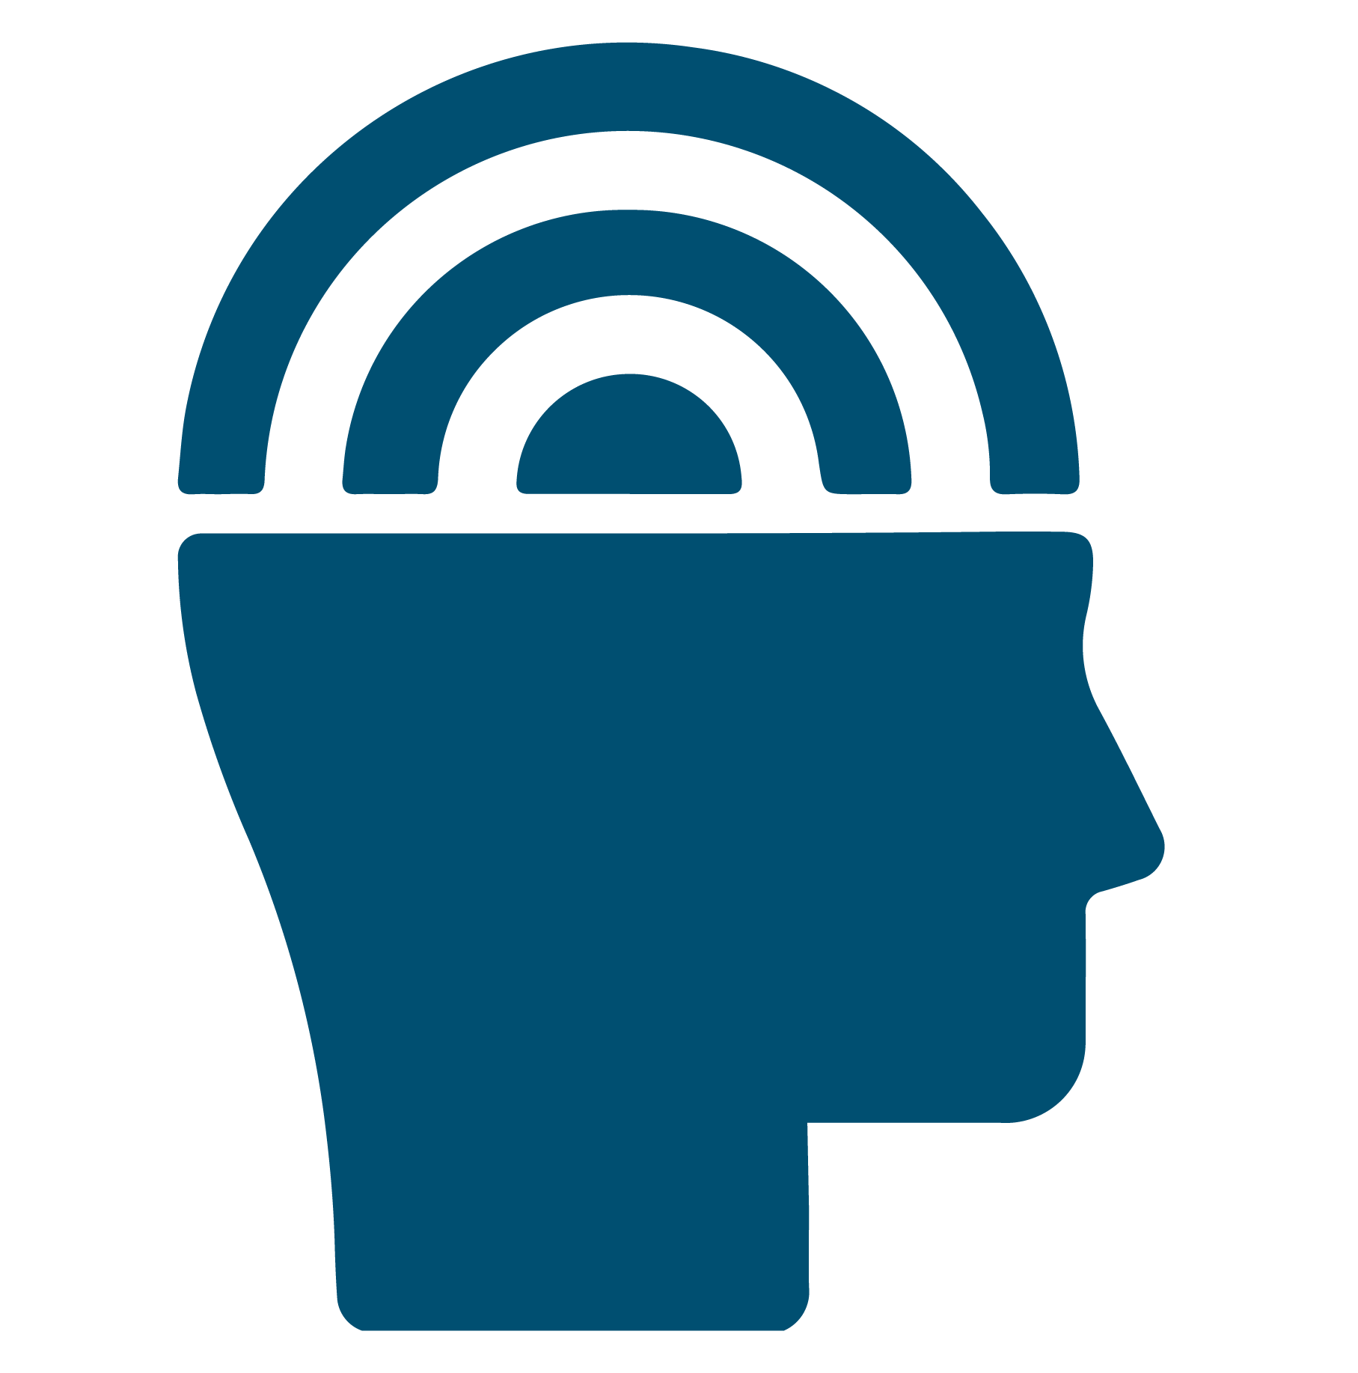
Renew My Mind: Building Emotional Intelligence (EI) to Promote Health​
RenewU Workshop
© University of Central Florida​
Notes:
Presenter note: Welcome to this session on "Building Emotional Intelligence to Promote Health". I (we) are glad you could attend and hope that you will learn something from this session and have a little opportunity to consider the role of emotional intelligence in your own life and relationships.

Slide 2

Important
Disclosures
Materials found on Renewunow.org
This material is for informational purposes only. It does not replace the advice or counsel of a health care professional. You should consult with and rely on the advice of your physician or health care professional for the management of your health. Never disregard professional medical advice or delay in seeking it because of something you have learned in this course.
© University of Central Florida​

Slide 3
Are you signed up to RenewU?
Register here to gain access to other RenewU resources and complete a brief post-session survey!
© University of Central Florida
Notes:
Presenter notes: Encourage participants to register for RenewU and complete the post-session survey (Only 3 Questions) RenewU has resources for individuals that offer continuing education credits for all ten featured interventions on RenewU.
By a show of hands determine if anyone needs to register and please allow 5-10 minutes at the beginning for participants to complete registration process if anyone is doing so.

Slide 4


This Module will Answer the Following Questions?
  What is Emotional Intelligence (EI)?​
  What are the benefits of EI?​
  How can I measure my EI? ​
  How can I develop EI?
© University of Central Florida​
Notes:
In review of our time today, we will be learning about emotional intelligence, what it is and why it might be a useful skill for your to develop. You will have an opportunity to complete a survey that will give you an idea of your own emotional intelligence level and identify areas where you have strong skills, as well as emotional intelligence areas that you can refine or develop.

Slide 5


What is Emotional Intelligence (EI)?
Unlike how smart you are, EI is a type of intelligence that considers how well you can:​
Identify and control your emotions and thoughts​
Recognize and understand other's emotions​
Control your focus and actions so that you can solve problems or achieve your goals
© University of Central Florida​
Notes:
We are all certainly familiar with 'intelligence' - generally referring to how 'smart' one is. And there are measures of that kind of intelligence, which is more related to how much and how quickly someone can learn, remember or recall information, their problem solving abilities, and how much information they can process at one time. That type of intelligence is more related to memory and cognitive (brain) functioning - or "thoughts"​
​
Emotional intelligence relates to 'feelings' and the "thought-feeling" relationship. There are various definitions and theories about emotional intelligence but the one we will focus on today defines emotional intelligence as - how well you can identify and control your emotions and thoughts, how well you can fecognize and understand other's emotions and how well you can control your focus and actions so that can solve problems or achieve your goals.​
​
And most people who study emotional intelligence consider it more like a skill you can develop than a trait you are born with. And our discussions today are based on that assumption as well...so whatever your current level of emotional intelligence, you aren't stuck there, you can develop emotional intelligence, you can become emotionally 'smart'.

Slide 6

What are the Benefits of EI?
Lower
Levels:
Higher
Levels:
Stress​
Worry or anxiety​
Depression​
Burnout
Physical, mental, emotional, exhaustion
Work performance & satisfaction​
Work interest, attention & productivity
Health​
Well-being
© University of Central Florida​
Notes:
Why does emotional intelligence matter? It matters because, according to studies, people with higher levels of emotional intelligence are less emotionally reactive and report less stress, declines in mood, negative emotions like anxiety and depression, burnout and exhaustion than people with lower levels of emotional intelligence. People with higher levels of emotional intelligence are also more engaged and productive at work, perform better educationally, report more job satisfaction and better health and well-being than people with lower levels of emotional intelligence. ​
​
Considering all the benefits, there is really not anyone who couldn't benefit from building or improving their emotional intelligence skills. ​
​
So Where do you begin?

Slide 7
Dugué, et al., 2021.
Article Summary:
Higher emotional intelligence (EI) promotes well-being and decreases stress/stress-related behaviors, symptoms of anxiety and depression.

Slide 8
Findings (Dugué, et al., 2021.)
Nursing students with higher EI in a review of 12 studies:
Increased:
Satisfaction with their life and happiness
Health and greater well-being
Nutritionally balanced diet
Sleep quality
Decreased:
Levels of stress, anxiety, and depression
Propensity for burnout
Consumption of alcohol
Risk for suicidal thoughts
Notes:
Presenter notes: article findings

Slide 9
Lin, et al., 2016.
Article Summary:
Higher emotional intelligence (EI) promotes well-being and decreases symptoms of depressions.

Slide 10
Findings (Lin, et al., 2016.)
Correlations
  Higher EI directly correlated with psychological well-being (r = 0.74; p < 0.001).
  Higher EI inversely correlated with:
  Emotional exhaustion (r = 0.69; p < 0.001)
  Depersonalization (r = 0.59; p < 0.001)
  Depression (r = 0.69; p < 0.001).
Regression models
  In this regression analyses, when controlling for demographic factors (e.g., sex, age, and relationship status), high EI was strongly predictive of:
  Increase in psychological wellbeing (beta = 0.76; p < 0.001)
  Decrease in depression (beta =-0.60; p < 0.001)
  Decrease in emotional exhaustion (beta=-0.63; p < 0.001)
  Decrease in depersonalization (beta =-0.48; p < 0.002)
Notes:
Presenter notes: article findings

Slide 11
Karimi, et al., 2020.
Article Summary:
Higher emotional intelligence (EI) promotes well-being, psychological empowerment and quality of patient care.

Slide 12
Findings (Karimi, et al., 2020.)
There was statistically significant improvement in emotional intelligence, well-being, psychological empowerment scores and self-reported quality of resident's care for the experimental group at the end of the study.
  Emotional intelligence: t-test(degree of freedom); t(24) = -3.67, p = 0.001
  Well-being: t(26) = 3.00, p = 0.006
  Psychological empowerment: t(26) = -2.82, p = 0.009
  Quality of resident's care: t(26) =-2.99, p = 0.006
No improvement was observed for the control group in emotional intelligence, well-being, psychological empowerment or self-reported quality of resident's care.
Notes:
Presenter notes: article findings

Slide 13
Nooryan, et al., 2011.
Article Summary:
Higher emotional intelligence (EI) promotes well-being and psychological empowerment, while decreasing symptoms of anxiety.

Slide 14
Findings (Nooryan, et al., 2011.)
Study findings show that mean scores of emotional intelligence (EI) in all of participants in case group compared to the control group after EI education items were significant, demonstrating the effectiveness of EI education.
EI education items – Self-regard, Self-awareness, Assertiveness, Independence, Self-actualization, Empathy, Social responsibility, Interpersonal, Stress tolerance, Impulse control, Reality testing, Flexibility, Problem solving, Optimism, Happiness
Total EI score after education (P < 0.0001):
  Intervention group: 516.88 (SD: +/- 55.56)
  Control group: 453.56 (SD: +/- 31.58)
Notes:
Presenter notes: article findings

Slide 15
Tadmor, et al., 2016.
Article Summary:
Higher emotional intelligence (EI) promotes intrapersonal and interpersonal skills, general mood and adaptability, while decreasing stress through promotion of stress management skills.

Slide 16
Findings (Tadmor, et al., 2016.)
Main Scales of the Assessment: Intrapersonal skills showed the greatest improvement (Standard mean deviation=8; p = 0.001), followed by interpersonal skills (SMD=5.3; p = 0.001), general mood (SMD=5.5; p = 0.008), adaptability (SMD=5; p = 0.009), and stress management (SMD=4; p = 0.089). In contrast to pre-training, in which only one of the main scales was slightly above average (101.6), at post training, all five main scales were higher than the average values which is 100 (105.9, 106.9, 103.8, 103.1, and 102.3).
Sub-scales of the Assessment: Significant positive shifts were also found in 12 of the 15 subscales, ones with the highest shifts were self-actualization (+/- 7.9), interpersonal relations (+/- 6.7), assertiveness (+/- 6.4), flexibility (+/- 6.1), and self-regard (+/- 5.9). Post training, 14 of 15 EI skills were above the average (in contrast to one at pretraining).
Notes:
Presenter notes: article findings

Slide 17

Mechanisms for the Health Effects of Emotional Intelligence
Physiological-Cognitive Mechanism: The Amygdala
Interpersonal Mechanism
Johnson, 2015.
Côté & Miners, 2006.
Notes:
Presenter notes:
Physiological-Cognitive Mechanism: The Amygdala – Individuals with higher Emotional Intelligence have greater capacity to override primitive parts of the brain and instead utilize higher order areas of the brain in response to stress. That means that, if you have higher levels of emotional intelligence, you are more likely to be operating from how you ”think” about a situation than how you ”feel” about a situation.
Interpersonal Mechanism – Cote and Miners proposed a cascading model, where emotion perception precedes emotion understanding, which leads to conscious emotion regulation, positively impacting job pergormance.

Slide 18
Perception of Emotions
How can I Develop Emotional Intelligence (EI)?
Managing Own Emotions
Managing Other’s Emotions
Utilization of Emotions
© University of Central Florida​
Notes:
Presenter notes: ​
You can learn about different types of emotional intelligence that the Assessing Emotions Scale measures​
​
Where to begin hint: If you took the Assessing Emotions Scale, each type of emotional intelligence match the different scores you received. Where did you score the lowest? That might be a good place to start learning about emotional intelligence skills you can develop in that area!​
​
Here is the type of emotional intelligence each factor is associated with.​
​
Factor 1: Perception of Emotions – Individuals who score high on this factor are ‘empathic’. They are aware of their own emotions and can recognize the emotions of others based on non-verbal cues. They are aware of changes in their own, and others’, emotions and able to understand why someone feels the way they do. ​
​
Factor 2: Managing Own Emotions – Individuals who score high on this factor are competent at controlling their emotions. They capitalize on positive emotions, seek situations that make them happy. When faced with obstacles, they expect to do well and to have good things happen to them and they use previous successes to stay motivated to overcome obstacles. ​
​
Factor 3: Managing Other’s Emotions – Individuals who score high in this factor focus on other’s feelings or how others experience them. They like to make a good impression, seek out opportunities that others will enjoy and comfortably praise other’s success. They are comfortable talking about their own feelings and problems with others and, since people are likely to find empathic support from individuals with high scores in this factor, they are likely confidants for others.​
​
Factor 4: Utilization of Emotions – Individuals who score high on this factor likely see a connection between changes in their mood and their ability to come up with new ideas and creatively solve problems. Their vision and perspective are guided by emotions and life events.​
​
​
​
​
​

Slide 19
Small Group Discussion prior to Self-Assessment
Consider your/our team, unit, or department - ​
  What area would "we" rate high in Emotional Intelligence? Why or why not?​
  Which of the four areas would our team, department, or unit be strongest in? Which would we be weakest in?
© University of Central Florida​
Notes:
Presenter notes: Discuss the perceived EI of the team prior to completing individual assessment of Emotional Intelligence.

Slide 20
How Emotionally Intelligent are You?
You can learn about your own Emotional Intelligence (EI) by taking the Assessing Emotions Scale, an EI self-assessment.​
You will learn about your overall level of emotional intelligence, the areas where you have the strongest skills and some areas where you can build more skills.​
Be sure to record your scores!​
© University of Central Florida​
Notes:
You can begin by completing a survey that provides a measure of emotional intelligence called the "Assessing Emotions Scale", then complete the self-reflection.
Self assessment link: https://edtech.med.ucf.edu/files/HRSA/EI-Self-Assessment/story.html

Slide 21
Large Group Debrief
Team Score
Were your predictions close?​
  If there are differences: What were the differences? Why might that be? What are the implications for the team, department, unit?
  Which factor does the team, unit, department score highest? Lowest? What implications does this have? How might more skill development in the factors the team scored lower in impact team functioning or the workplace?
© University of Central Florida​
Notes:
Presenter notes: Option 1​
​
If USING the Team Score feature, display the results of the team score:​
Highlight how the participant’s perceptions of the level of overall EI score discussed earlier in the session compares to the overall EI as depicted in the scores.​
Are they close?​
If there are differences – which is higher? Why might that be? What are the implications for the team? Department? Unit? As a result of the gap?​
Which factor does the team, unit, department score highest? Lowest? What implications does this have for the team? How might more skill development in the factors the team scored lower in impact team functioning? The workplace? ​
If NOT USING the Team Score feature, discuss the following questions.​
Consider the following if you had to provide an EI score to the organization, clinic or team.​
After reading more about the factors, what EI factors do you think our culture promotes? Did it change?​
What EI factors would you like to see promoted on our team?​
What are some ways our team could promote EI in the area(s) identified in the second question?​

Slide 22
Building Emotional Intelligence Skills
Level 1:
Complete the provided EI self-assessment and
reflection.
Based on your results choose a factor of EI and complete the associated
activities.
Level 2:
Choose two other
factors of EI and complete the associated activities.
Level 3: Complete the activities for the remaining EI factor and
self-reflection.
© University of Central Florida​
Notes:
You are certainly encouraged to learn more about how to develop EI skills in at least one area. But you are welcome to explore each area and learn more about how to build your EI skills overall.

Slide 23
Conclusion
Take Home Points:
Research has confirmed associations between higher levels of emotional intelligence (EI), with physical and emotional benefits, as well as higher levels of engagement, productivity and overall well-being.​
Emotional Intelligence is not static. It is a skillset that can be developed.​
Considering the numerous benefits of EI, developing EI could be one of the 'highest yield' for effort investments you could make for your overall health and well-being
© University of Central Florida​

Slide 24
Options:
Future workshop sessions that focus on weaker areas of EI for the team.​
Team goal to complete skill development tasks related to the weaker areas of EI for the team.​
Team goal to continue EI training, in all four factors.
What’s
Next
© University of Central Florida​

Slide 25
References
Bar-On, R. (2006). The Bar-On model of emotional-social intelligence (ESI). Psicothema, 18(Suppl), 13-25. https://psycnet.apa.org/record/2006-12699-003
Côté, S., & Miners, C. T. H. (2006). Emotional intelligence, cognitive intelligence, and job performance. Administrative Science Quarterly, 51(1), 1-28. https://doi.org/10.2189/asqu.51.1.1
Dugué, M., Sirost, O., & Dosseville, F. (2021). A literature review of emotional intelligence and nursing education. Nurse Education in Practice, 54(103124). https://doi.org/10.1016/j.nepr.2021.103124
Jiménez-Picón, N., Romero-Martín, M., Ponce-Blandón, J. A., Ramirez-Baena, L., Palomo-Lara, J. C., & Gómez-Salgado, J. (2021). The Relationship between mindfulness and emotional intelligence as a protective factor for healthcare professionals: Systematic review. International Journal of Environmental Research and Public Health, 18(10), 5491. https://doi.org/10.3390/ijerph18105491
Johnson, D. R. (2015). Emotional intelligence as a crucial component to medical education. International Journal of Medical Education, 6. 179-183. https://doi.org/10.5116/ijme.5654.3044
Karimi, L., Leggat, S.G., Bartram, T., Rada, J. (2020). The effects of emotional intelligence training on the job performance of Australian aged care workers. Health Care Management Review, 45(1), 41-51. https://doi.org/10.1097/hmr.0000000000000200
Lin, D. T., Liebert, C. A., Tran, J., Lau, J. N., & Salles, A. (2016). Emotional intelligence as a predictor of resident well-being. Journal of the American College of Surgeons, 223(2), 352-358. https://doi.org/10.1016/j.jamcollsurg.2016.04.044

Slide 26
References Continued
Mikolajczak, M. (2009). Going beyond the ability-trait debate: The three-level model of emotional intelligence. E-Journal of Applied Psychology, 5(2), 25-31. https://psycnet.apa.org/record/2010-10941-004
Nooryan, K., Gasparyan, K., Sharif, F., & Zoladl, M. (2011). The effect of teaching emotional intelligence (EI) items on job related stress in physicians and nurses working in ICU wards in hospitals, Yerevan, Armenia. International Journal of Collaborative Research on Internal Medicine & Public Health, 3(10), 704-713. https://www.researchgate.net/publication/286981732_The_Effect_of_Teaching_Emotional_Intelligence_EI_Items_on_Job_Related_Stress_in_Physicians_and_Nurses_Working_in_ICU_Wards_in_Hospitals_Yerevan_Armenia
Pérez-Fuentes, M. D. C., Molero Jurado, M. D. M., Gázquez Linares, J. J., & Oropesa Ruiz, N. F. (2018). The role of emotional intelligence in engagement in nurses. International Journal of Environmental Research and Public Health, 15(9), 1915. https://doi.org/10.3390/ijerph15091915
Salovey, P., & Sluyter, D. J. (Eds.). (1997). Emotional development and emotional intelligence: Educational implications. Basic Books.
Schutte, N. S., Malouff, J. M., Hall, L. E., Haggerty, D. J., Cooper, J. T., Golden, C. J., & Dornheim, L. (1998). Development and validation of a measure of emotional intelligence. Personality and Individual Differences, 25(2), 167-177. https://doi.org/10.1016/S0191-8869(98)00001-4

Slide 27
References Continued
Schutte, N. S., Malouff, J. M., & Bhullar, N. (2009). The Assessing Emotions Scale. In C. Stough, D. H. Saklofske, & J. Parker (Eds.), Assessing Emotional Intelligence (1st ed., pp. 119-136). Springer. http://dx.doi.org/10.1007/978-0-387-88370-0_7
Tadmor, T., Dolev, N., Attias, D., Lelong, A. R., & Rofe, A. (2016). Emotional intelligence: A unique group training in a hematology-oncology unit. Education for health (Abingdon, England), 29(3), 179-185. https://doi.org/10.4103/1357-6283.204221

Slide 28
Please Complete the Post-session Survey
Register to gain access to other RenewU resources & complete a brief post-session survey!
Post-session survey link:
© University of Central Florida​
Notes:
Presenter notes: Encourage participants to register for RenewU and complete the post-session survey (Only 3 Questions) RenewU has resources for individuals that offer continuing education credits for all ten featured interventions on RenewU.
*If this is the first RenewU post-session or module survey they are completing they are eligible to receive a $25 gift card.

Slide 29
Disclosure
This project was supported by the Health Resources and Services Administration (HRSA) of the U.S. Department of Health and Human Services (HHS) under grant number 6 U3NHP45418 of the Health and Public Safety Workforce Resiliency Training Program for $1,496,128. This information or content and conclusions are those of the author and should not be construed as the official position or policy of, nor should any endorsements be inferred by HRSA, HHS or the U.S. Government.
© University of Central Florida
Notes:
Presenter notes: please show the disclosure after presentation

